Slide 1
T-BFA Results Comparison and Time Overheads

Slide 2
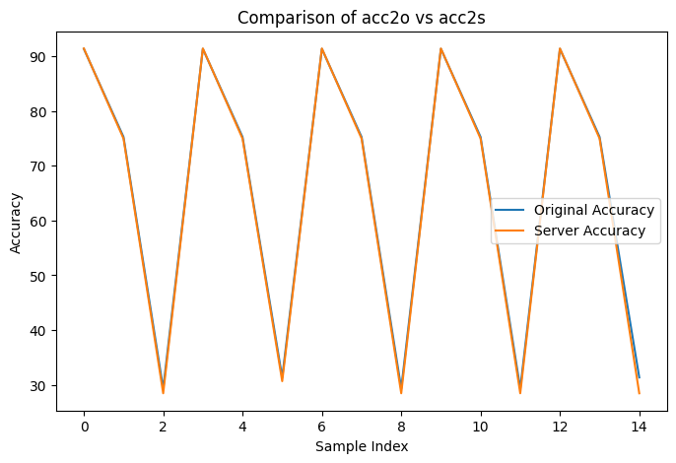
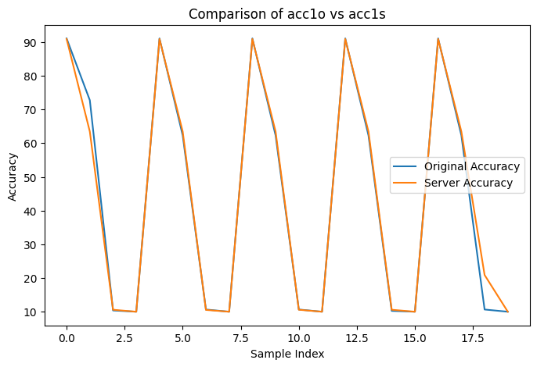
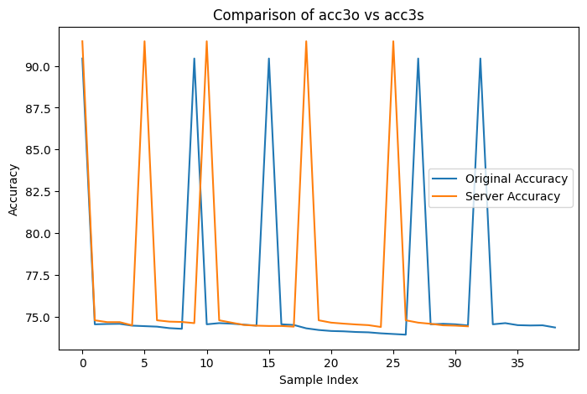
Accuracy Comparison
Each tested for 5 rounds

Slide 3
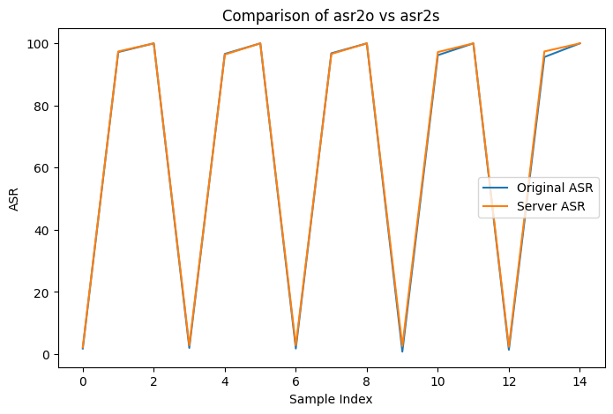
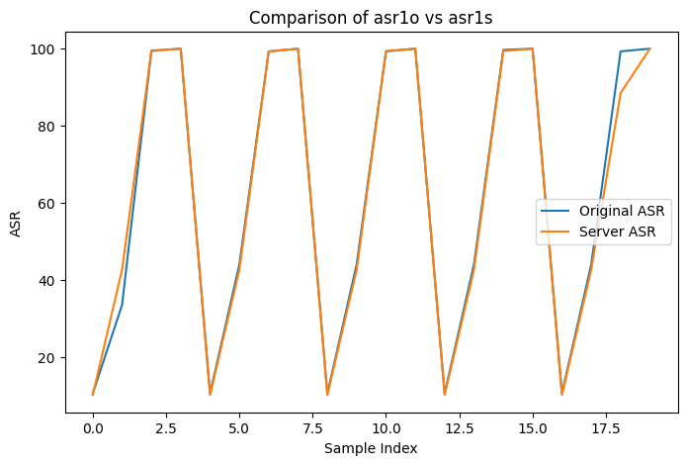
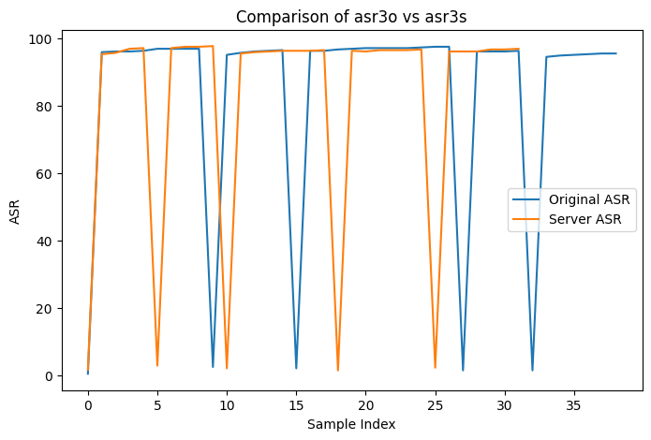
ASR Comparison
Each tested for 5 rounds

Slide 4
Time Overheads
Attack Type | Avg Bit-Flip Time (Sec) | Avg Intra-Layer TIme (sec) | Avg Inter-Layer Time (Sec)*
Type I | e.g. 0.0042 | e.g. 0.0400 | e.g. 0.57
Type II | e.g. 0.0041 | e.g. 0.0380 | e.g. 0.47
Type III | e.g. 0.0056 | e.g. 0.0495 | e.g. 0.92
*The average inter-layer time is the total time taken for the entire loop, which is the sum of all intra-layers and their corresponding bit flips.

Slide 5
FL2R & CZR

Slide 6
Introduction
CZR: how to reconstruct missing bits in quantized weights
FL2R: how to pick the most impactful bits to flip.
Quantized Weights & Two’s-Complement Refresher:
Quantized DNN stores weights as fixed-width ints (e.g. 8-bit)
Two’s-complement: MSB is sign; remaining bits give magnitude
Partial recovery → some bits zeroed out, some unknown

Slide 7
CZR: Closer-to-Zero Reconstruction
For each weight: look at which bits are recovered vs. masked
If sign bit is known:
Positive → set all unknowns to 0
Negative → set all unknowns to 1
If sign bit is unknown:
Build two candidates: assume sign=0 vs. sign=1
Convert both to signed ints; pick the one whose absolute value is smaller

Slide 8
FL2R: Filter-wise $L_{2}$ Ranking
Why L₂? captures overall energy of each filter
Normalized per-filter: divide $||F_{i}^{l}||_{2}$ by filter size to compare filters fairly
Loop:
Find filter $f$ with highest normalized $L_{2}$
Within $f$, locate the single parameter with max $|value|$
Flip its sign bit (MSB) → simulate attack step
Recompute $f$’s $L_{2}$ in the “working” copy
Repeat until you’ve selected $N$ flips

Slide 9
GPUHammer: Rowhammer Attacks on GPU Memories are Practical (2025)
Chris S. Lin, Joyce Qu, Gururaj Saileshwar
Presenter: Amirmohammad Pournaghshband

Slide 10
Introduction
Rowhammer is a hardware vulnerability that enables attackers to induce bit-flips in DRAM by rapidly accessing adjacent memory rows
GPUs are increasingly used for ML inference and high-performance computing, making them a critical target for security evaluation
No prior work had demonstrated a successful Rowhammer attack on discrete GPUs with GDDR6 memory due to proprietary architectures and high-speed memory behavior.

Slide 11
Contribution
First Practical GPU Rowhammer Attack: The paper demonstrates the first successful Rowhammer attack on NVIDIA GPUs (specifically the A6000 with GDDR6), showing bit-flips across four DRAM banks.
Reverse Engineering of DRAM Row Mapping: The authors develop a method to reverse-engineer the virtual address to DRAM bank/row mapping using row-buffer conflict latency measurements.
GPU-Specific Hammering Techniques: They implement high-intensity, synchronized, multi-warp hammering kernels tailored to the GPU’s parallel architecture, achieving up to 620K activations per refresh window.
Real-World Exploit on ML Models: The authors show that even a single bit-flip in FP16 weights can degrade model accuracy by up to 80%, affecting popular models like ResNet50 and InceptionV3.

Slide 12
Methodology
Building Activation Primitives:
Goal: Rapidly activate specific DRAM rows to induce bit-flips
Cache Eviction:
Use the discard PTX instruction to evict addresses from L2 cache
Combine it with .volatile load modifier to avoid L1 cache
This ensures memory loads go to DRAM every time, triggering row activations
Row-Buffer Conflict:
To activate a row, the previously accessed row in the same bank must be evicted

Slide 13
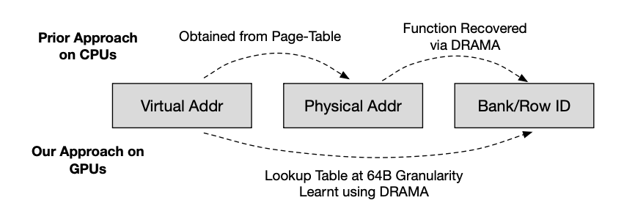
Methodology
Reverse Engineering Row and Bank Mapping:
Goal: Identify which virtual addresses map to the same DRAM bank and row
Problem: On GPUs, physical addresses are not exposed (unlike CPUs), so traditional DRAM reverse engineering methods don’t apply.
Solution: Use row-buffer conflict timing
When two addresses from the same bank but different rows are accessed back-to-back, a row-buffer conflict occurs, which increases access latency.

